Slide 1
JavaScript - introduction (Day 1)
Viktoras Lava www.viktoraslava.lt

Slide 2
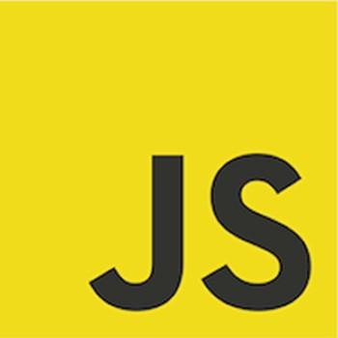
What is JavaScript?
JavaScript, often abbreviated as JS, is a high-level programming language, that firstly appeared in 1995.
Initially javascript was implemented only in front-end (client-side), however now you can find JS pretty everywhere - even in the server-side (backend) web servers and databases.

Slide 3
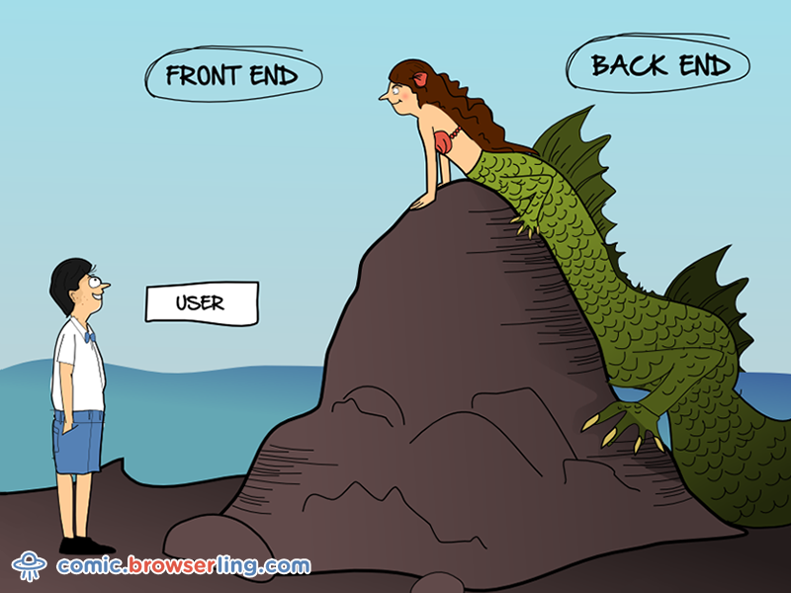
Differences between front-end and backend
Front-end is something that has a GUI (graphical user interface) and runs on your client’s browser.
Backend is something that usually doesn’t have a GUI, runs on your server (hardware), has a database, manages main logic.

Slide 4
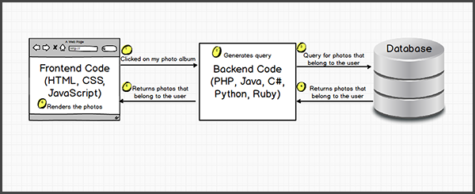
Front-end vs backend

Slide 5
How to start working with JS?
<script src="js/script.js">
</script>
In order to start programming you need to inject your JS inside your HTML document.
There are three ways to inject JS:
External
Internal
Inline

Slide 6
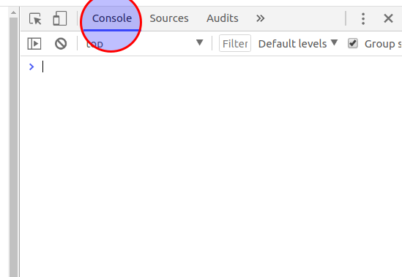
How to debug your JS code?
The best tool to debug your JS is your browser’s developer tools (inspect mode).
Make sure that there aren’t any errors in your console, otherwise your website might break.

Slide 7
Playing around in the console
You can communicate with your HTML document directly inside the browser’s console using JS programming language.
Try writing alert(‘hello’); inside your console.

Slide 8
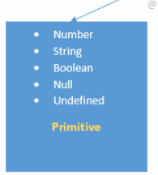
Javascript data types
There are 4 primitive data types in JS programming language:
Strings
Numbers
Booleans
Null

Slide 9

Strings
Strings are useful for holding data that can be represented as a text

Slide 10
Numbers
Numbers are useful for holding integers and floats
42; // Number
42.91; // Number

Slide 11
Booleans
Booleans are useful for defining logical values: true or false.
true; // on/yes
false; // off/no

Slide 12
Nulls
Nulls define an absence of value.
null; // Nothing

Slide 13
Saving data inside a variable
var vardas = 'viktoras';
Usually we save our data inside the variable that we would be able to access that data for later use.
To define a variable use keyword “var” and then specify the name.
Name should start with lower letter, spaces have to be replaced with _ character.

Slide 14
Properties
var vardas = 'viktoras';
vardas.length; // 8
When you create a data type in your browser then a new instance is created in your computer’s memory this process is called instantation.
Instance is a reference to that saved string with additional information. This additional information are called properties.

Slide 15
Methods
var vardas = 'viktoras';
vardas.toUpperCase();
Method is a function that does a very specific task and outputs the result. Method is attached to a created instance.
Use the method name and add () to an end of the method name - this will call the method. If you will forget to write () then JS will return the inside of your method.

Slide 16
Questions?

